Slide 1
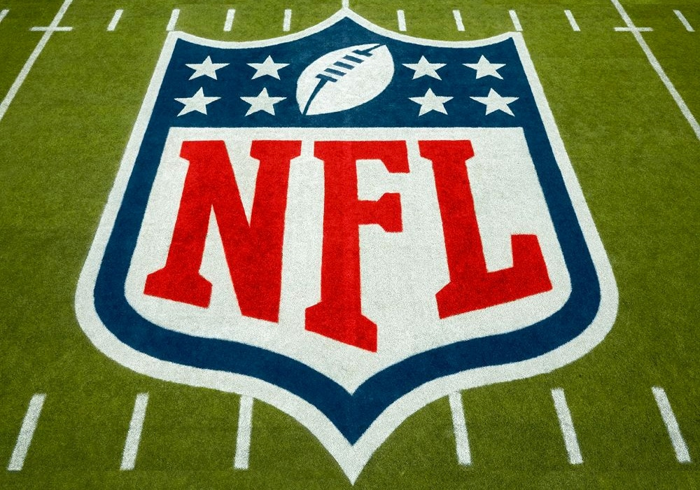
NFL Machine Learning
Hayden Dessommes, Rishi Rao, Evan McKenna, Daniel Zheng

Slide 2
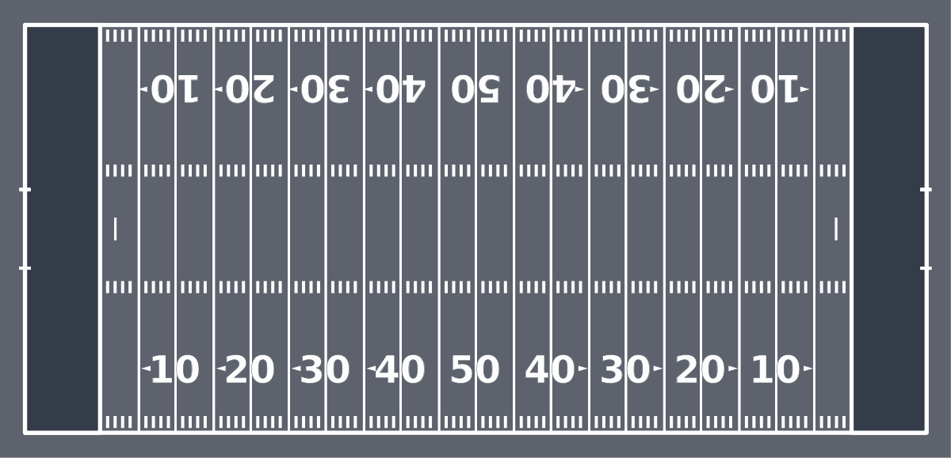
Context and Questions
The dataset we are using to conduct his exploration is a combination of information we thought would be important regarding the outcome of NFL football games, focusing on playcalling. The National Football League, or NFL, is a professional sports organization comprised of 32 teams, which compete in at least 17 games a season. Teams can run a variety of different offensive plays in an effort to gain yards and score such as a run, a pass, a punt, or a field goal. Our final dataset includes wins and losses of each game, the amount of times each play type is run, and estimated weather condition for seasons 2009-2018.

Slide 3
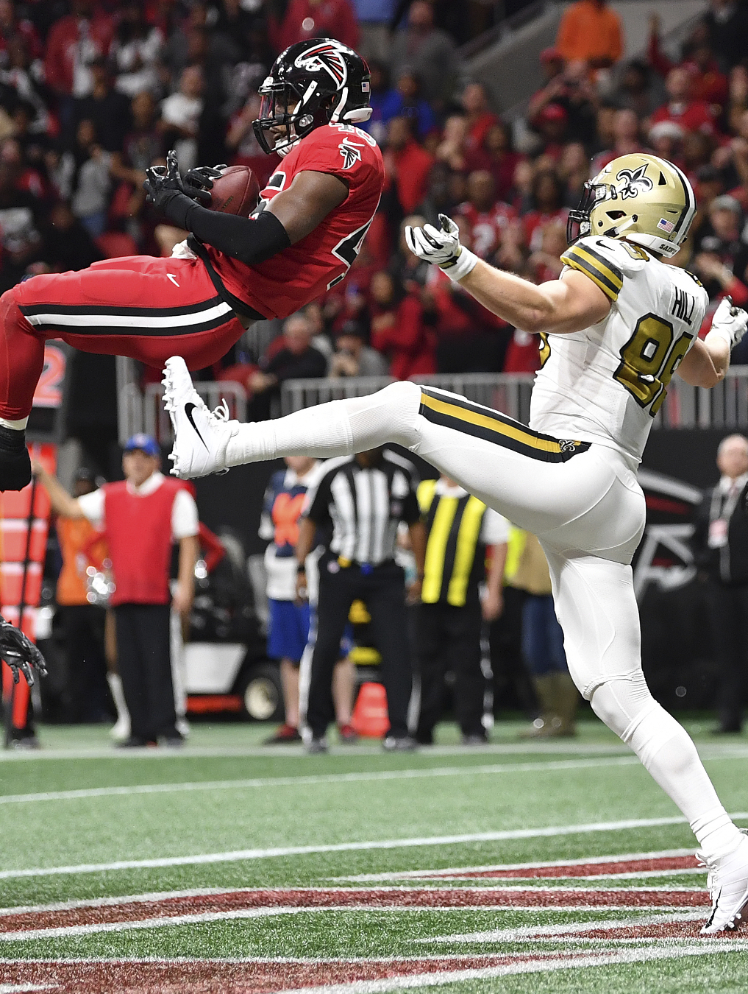
The question we are trying to answer is
“How can we predict whether a team will win based off the play calling and weather?”
In the NFL, coaches and teams are judged by their record. The difference in losing and winning even a single game can be the difference between a bad season and a good season. In this hyper-competitive league, play calling and the statistics around that are becoming more and more important as each team is trying to gain a edge. Knowing about the proportion of play calls that leads to success is very valuable and our goal is to better understand how play calling in a game can lead to a victory.

Slide 4
Data and Variables
Dataset Summary
Across 9 seasons
5153 observations
7 levels of Weather Conditions
E.g. Clear, Moderate rain, Light snow
32 Teams included
9 Play Types
The target of interest for our model is WL, an integer representing a win(1) or loss(0). We plan to analyze the following predictors: run, pass, extra_point, field_goal, punt, qb_spike, qb_kneel, kickoff, no_play, percent_run, percent_pass, estimated_condition
See the next two slides for a more in-depth look at these variables.

Slide 5
Variable | Data Type | Description | Relevant Statistics
WL* | Integer (0,1) | Result of game (0=loss, 1=win) | Mean - 0.4822 SD - 0.4997
Percent_run | Numeric | The proportion of run plays called in a game | Mean - 37.7450 SD - 11.6399
Percent_pass | Numeric | The proportion of pass plays called in a game | Mean - 52.8997 SD - 12.9074
Estimated Condition | character | Weather condition of the game | 7 possibilities(Clear, Li.Rain, Md. Rain, Hvy. Rain, Li. Snow, Md. Snow, No Data)
extra_point | Integer | Amount of extra points attempted | Mean - 2.1219 SD - 1.4299
field_goal | Integer | Amount of field goals attempted | Mean - 1.8973 SD - 1.3254

Slide 6
Variable | Data Type | Description | Relevant Statistics
punt | Integer | Number of punts called in a game | Mean - 4.6408 SD - 2.0247
qb_kneel | Integer | Number of quarterback kneels called in a game | Mean - 0.7433 SD - 1.0695
qb_spike | Integer | Number of quarterback spikes called in a game | Mean - 0.1339 SD - 0.4066
run | Integer | Number of run plays called in a game | Mean - 25.75044 SD - 8.44673
kickoff | Integer | Number of kickoffs in a game | Mean - 4.9587 SD - 1.9051
no_play | Integer | Number of downs without getting off a play | Mean - 8.1628 SD - 3.5361
pass | Integer | Number of pass plays called in a game | Mean - 36.2269 SD - 10.3990

Slide 7
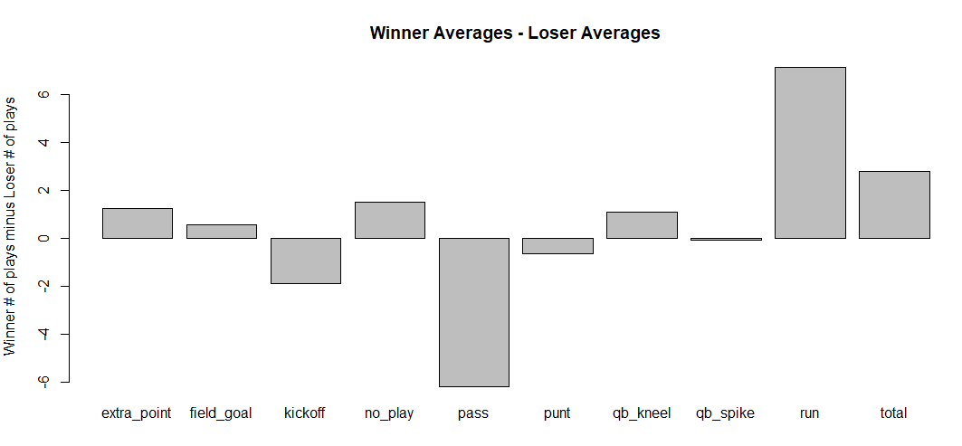
Visualizations
Winners, on average, call 6 more run plays per game.
Losers, on average, call 6 more passing plays per game.
Winners call more plays overall, as they likely have possession of the ball longer.

Slide 8
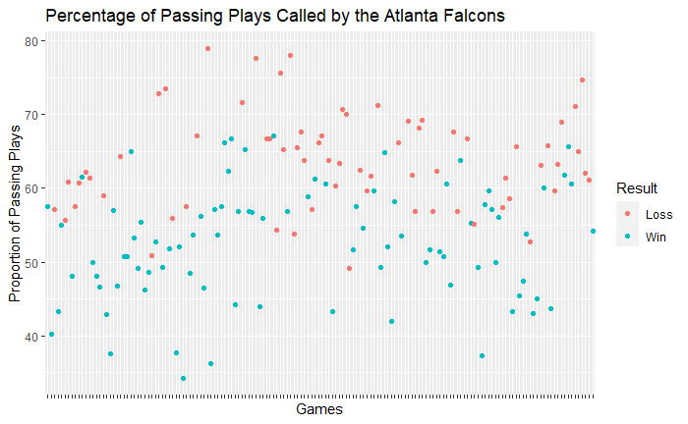
Visualizations
This is a graph of the percentage of passing plays called by the Atlanta Falcons colored by the result of the game.
The Falcons lose a majority of the games with a higher passing percentage and tend to win most games with a low passing percentage.

Slide 9
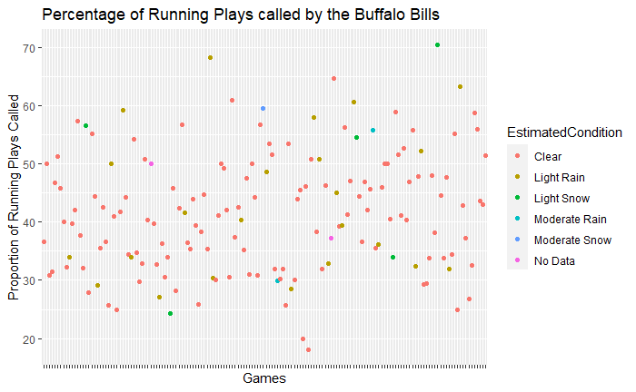
Visualizations
This graph illustrates the differences in run play calling by the Buffalo Bills in respect ot the weather conditions.
Most games are played in clear conditions
Their most run-heavy games tend to be in light rain or snow, but they still have some run-heavy games in clear conditions.

Slide 10
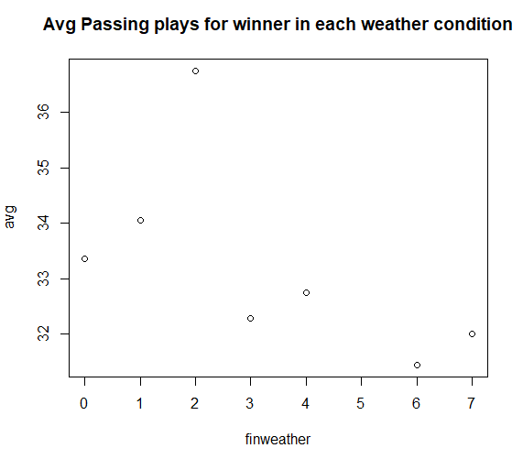
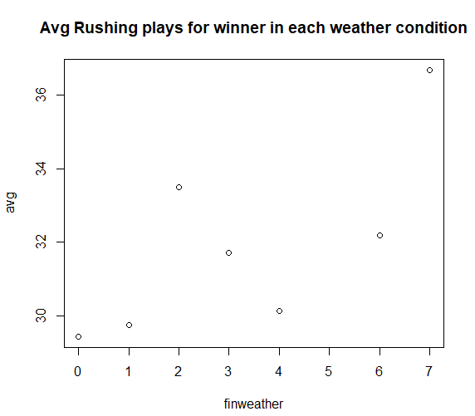
Visualizations
It is beneficial to pass more in clear weather and heavy rain, but not in moderate rain or snow.
Helps answer how play calling must be adjusted according to weather.
0= no data
1=clear
2=heavy rain
3=moderate rain
4=light rain
6=light snow
7=moderate snow

Slide 11
Method
We chose to use a supervised machine learning method to predict the result of a specific game, 1 corresponding to a win and 0 to a loss. We chose to use the General Logistic Model to train our model, as it produced the best results.
The classification metrics we will use to evaluate our model are accuracy, precision, and recall. We chose to use these performance metric because the success of our model is dependent on the binary prediction of Win vs. Loss.
While building the model we randomly sampled and split our data into a training and testing set by a 70:30 ratio to ensure we had enough data to make predictions off of, but still retained enough data not trained on to test our model. After checking the confusion matrix of our training set, we determined that overfitting was likely not an issue, as the model on both sets was able to explain approximately the same amount of variance in the data.

Slide 12
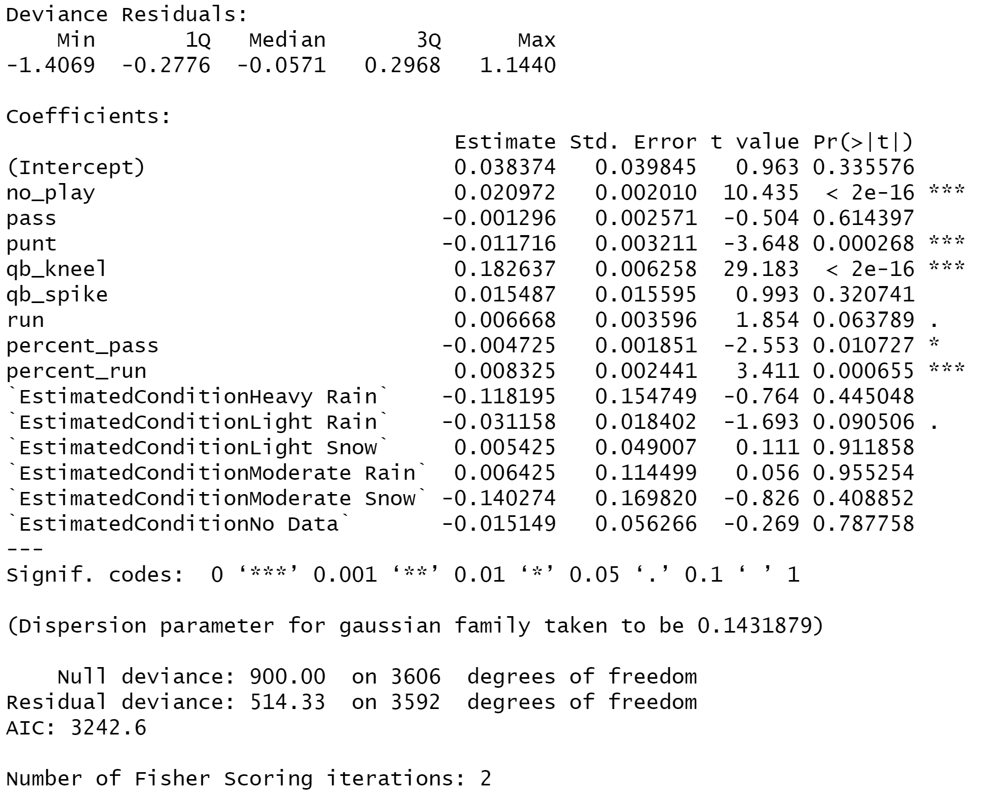
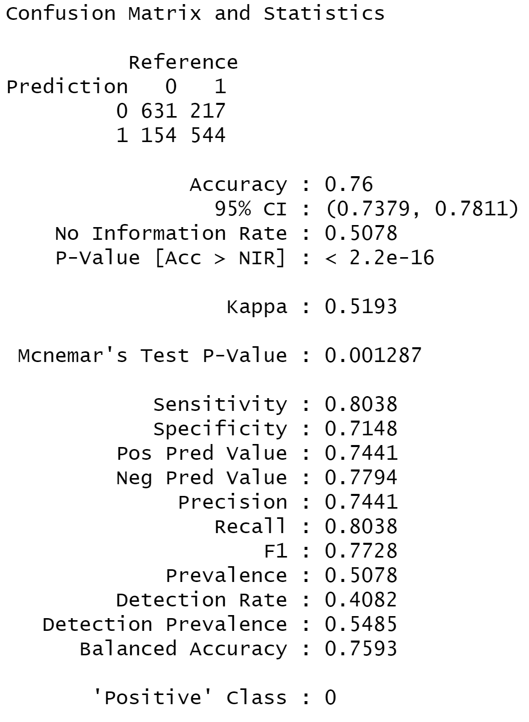
Results
Our logistic regression model did an exceptionally good job of predicting wins and losses with an accuracy of 0.76.
Useful predictors were number of plays, punts, QB kneels, percent run, and percent pass at a 0.05 p-value, leading us to believe that weather does not play a large role in predicting whether a team will win a game.
Precision and Recall were relatively similar, meaning the amount of false positives and false negatives were not alarming.

Slide 13
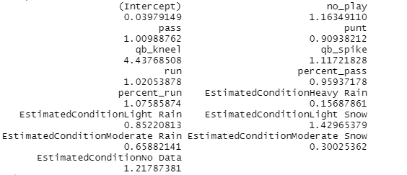
Results
This model answered our question: “How can we predict whether a team will win based off of play calling and weather?”
One way we can assess this question is by using our odds ratios pasted below.
For example, we can interpret this by saying a one unit increase in run (team does one more running play) increases the odds of winning by 1.0205. Alternatively, calling one more punt play will increase your odds of winning by 0.9092, which is a net decrease. However, not all of these variables will be useful, since some have high p-values and have little influence on the model

Slide 14
Limitations
There are a few limitations that came up as a result of using football statistics. First, football is an extremely complex game, and although we were as specific as it was feasible with play types, there are still many variations of run or pass plays that can be called for a variety of strategic reasons. Additionally, each team is comprised of different players with different skills. Because of this certain play calls would work better for some teams than others. Unfortunately, we could not base our model off of just one group of players as we would not have nearly enough data. The inclusion of more specific play types, possibly categorized by the intended result of the play, would have been helpful to include in this model, as we could account for differences within play types, but this data would be extremely hard to find or produce. Ultimately, we would not make an inference about causality with this model, as there is a strong possibility that play call may be correlated to the game situation, but not necessarily decide the final score.
Another additional limitation that could significantly affect play calling would be the subject of injuries. Our datasets did not include injuries for each game as that would have been far too complex and unique across each individual game. Nonetheless, an injured player could very easily result in certain data in our model to be skewed to favor either a tendency to pass or run. Having this data would have possibly helped explain outliers and/or decrease the standard deviation of certain variables.

Slide 15
Recommendations
Winning teams almost always run the ball more often.
In heavy rain, passing the ball may be beneficial, contrary to popular belief.
In snow, running the ball will be more beneficial.
Most important aspects towards winning are number of plays, punts, QB kneels, percent run, and percent pass, other aspects to not matter as much.
Use odds ratios to determine whether certain plays will help or hurt your chances of winning.

